Slide 1
Programming Fundamentals using python

Slide 2
TABLE OF CONTENTS
01
02
03
Introduction to Python
Anaconda
Python Script

Slide 3
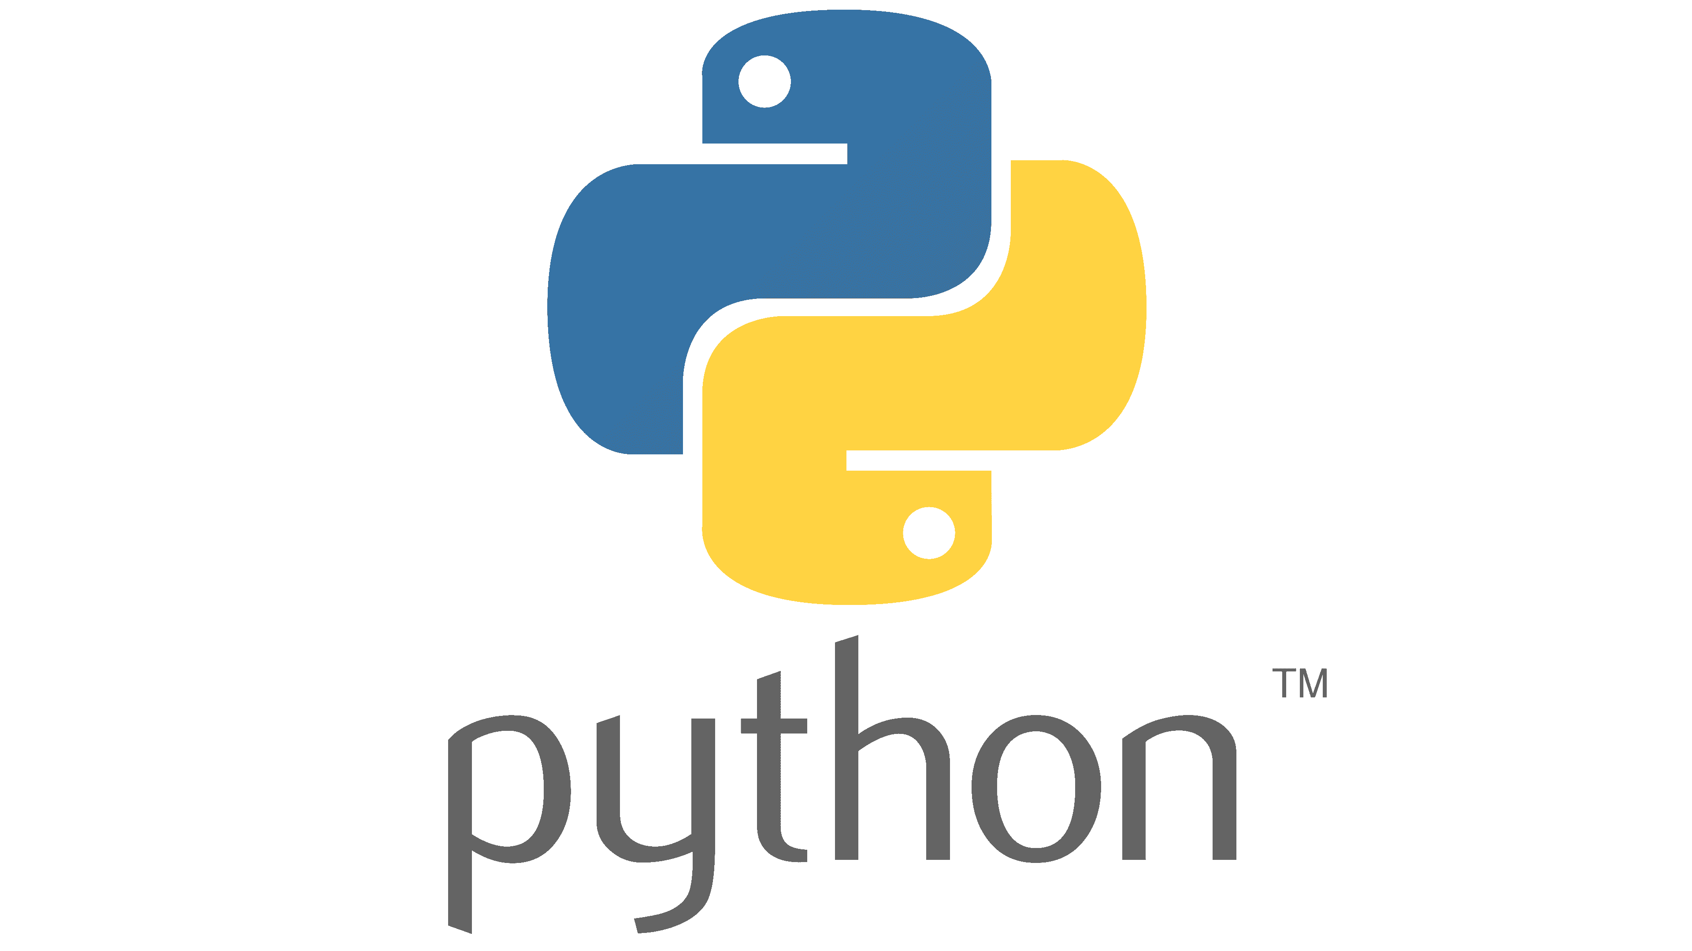
INTRODUCTION to Python
Guido van Rossum created the Python programming language in the late 1980s.
Python strives to provide a simple but powerful syntax.
Python is used for software development at companies and organizations such as Google, Yahoo, Facebook.

Slide 4
Versions of Python
In late 2008, Python 3.0 was released. Commonly called Python 3, the current version of Python is incompatible with earlier versions of the language.
Currently the Python world still is in transition between Python 2 and Python 3.

Slide 5
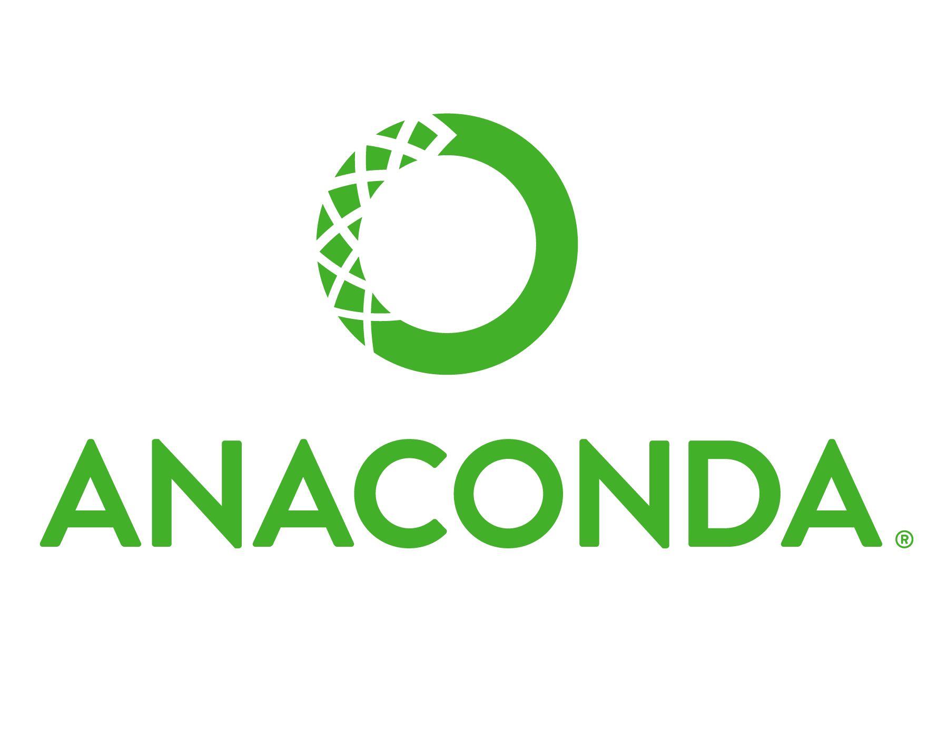
Anaconda
Anaconda is a free and open-source distribution of the Python and R programming languages for scientific computing.
It simplifies the package management and deployment.
Package versions are managed by the package management system conda.

Slide 6
Benefits of Using Python Anaconda
Libraries
Models
Analysis
Visualization
Quickly download 1,500+ Python/R data science packages. Manage libraries, dependencies, and environments with Conda
Develop and train machine learning and deep learning models with scikit-learn, TensorFlow, and Theano
Analyze data with scalability and performance with Dask, NumPy, pandas,and Numba
Visualize results with Matplotlib, Bokeh, Datashader, and Holoviews

Slide 7
Interpreter
Compiler
Interpreter Vs Compiler
Translates program one statement at a time.
Scans the entire program and translates it as a whole into machine code.

Slide 8

Python Script
Spyder is an open source cross-platform integrated development environment for scientific programming in the Python language.
Spyder has all the benefits of a comprehensive development tool with the competences of a scientific package.
Programmers can extend Spyder by installing other plugins. Additionally, developers can use Spyder as a PyQt5 extension library.

Slide 9
THANKS!
Do you have any questions?
If yes, then comment.

